Slide 1

Syrian Private University
faculty of Information Engineering Telecommunication Engineering
First presentation of the semester project
Smart Satellite Transponder جهاز إعادة البث الفضائي الذكي
Prepared by: MHD.Nour Njeeb LaithAbdAlrazek
Supervisors: Dr.Nawaf Altawel Dr. Rawad Melhem
Date: 16/11/2025

Slide 2

OUTLINE:
Project objective .
Problem statement & importance.
Implementation steps.
Theoretical background.
Implementation Smart Transponder Architecture.
- References.

Slide 3
1- Project objective:
Study and design of smart satellite transponder.

Slide 4


2_Problem statement & importance:
2.1_The Problem:
2.2_The Importance:
Traditional transponders have fixed functionality and cannot adapt to changes in data demand.
Inefficient use of bandwidth and transmission power.
Lack of flexibility in dealing with interference or unexpected conditions.
Meeting the growing demand for high-speed communication services (e.g., in-flight internet, maritime communications, remote areas).
Maximizing the return on the high cost of satellite launch and operation.
More flexible and efficient satellite communication networks.

Slide 5
3_Implementation steps :
Simulation of transponder model.
Development the model.
Study the fundamentals.
Practical design for the model.
Testing & development the model.

Slide 6
4_Theoretical Fundamentals :
Communication segments: Space & Ground.
Satellite orbits: GEO, MEO, LEO, HEO.
Transponder types: Bent Pipe vs Smart (On-board Processing).
Polarization Diversity.

Slide 7
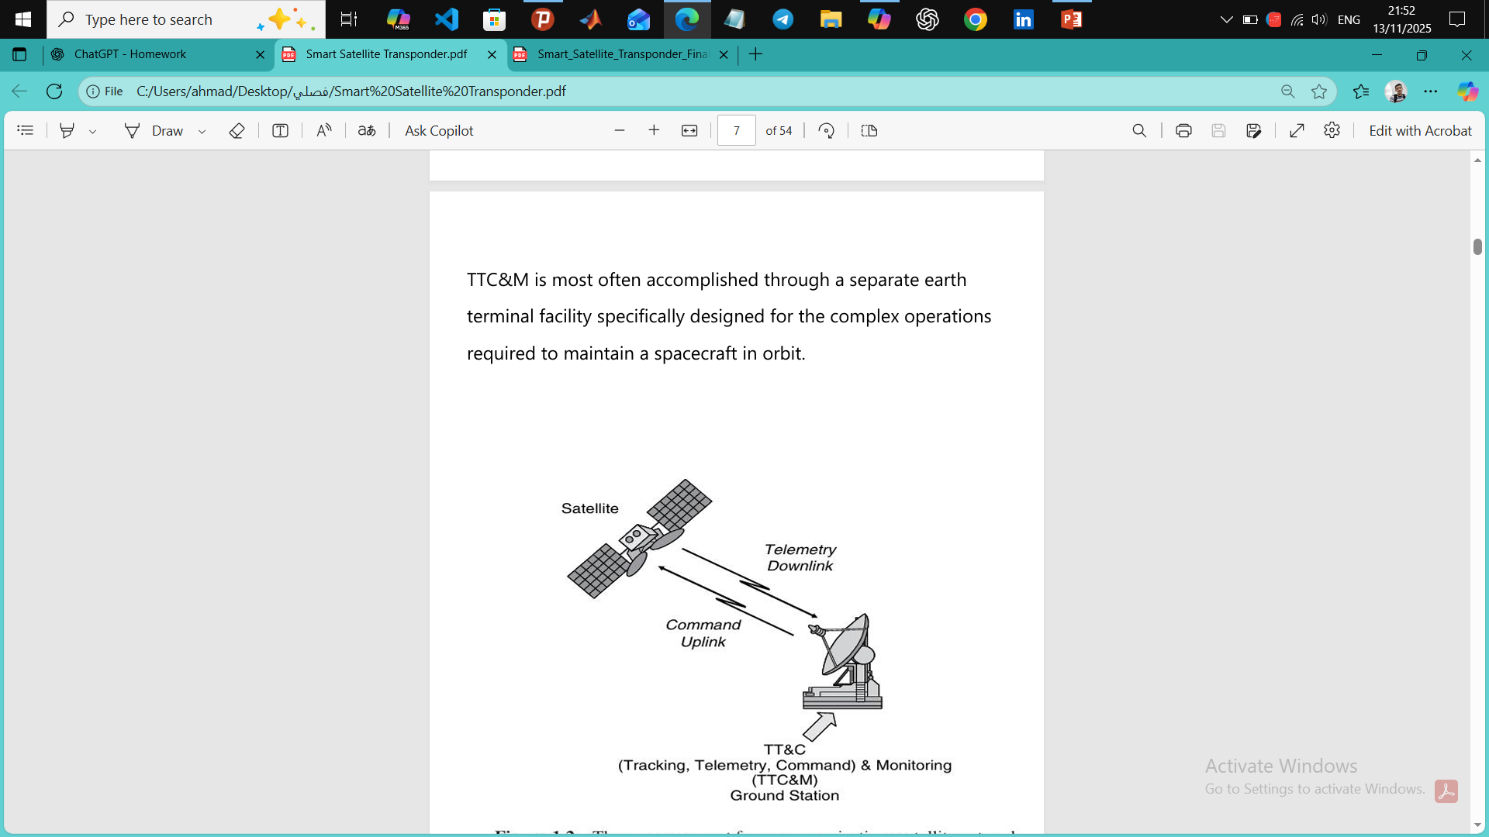
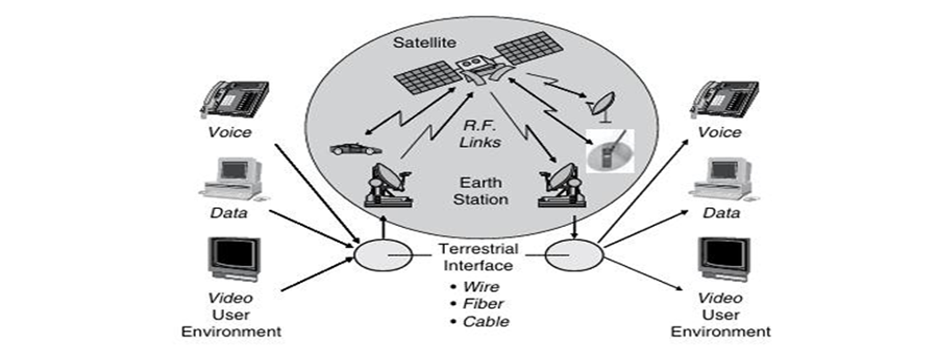
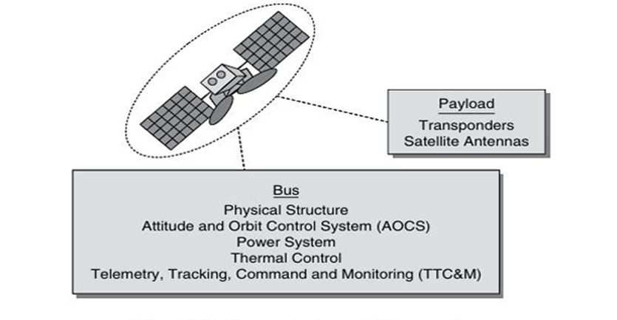
4.1.1_Ground Segment
4.1.2_Payload Components
Form a_4.1.1
Form b_4.1.2

Slide 8
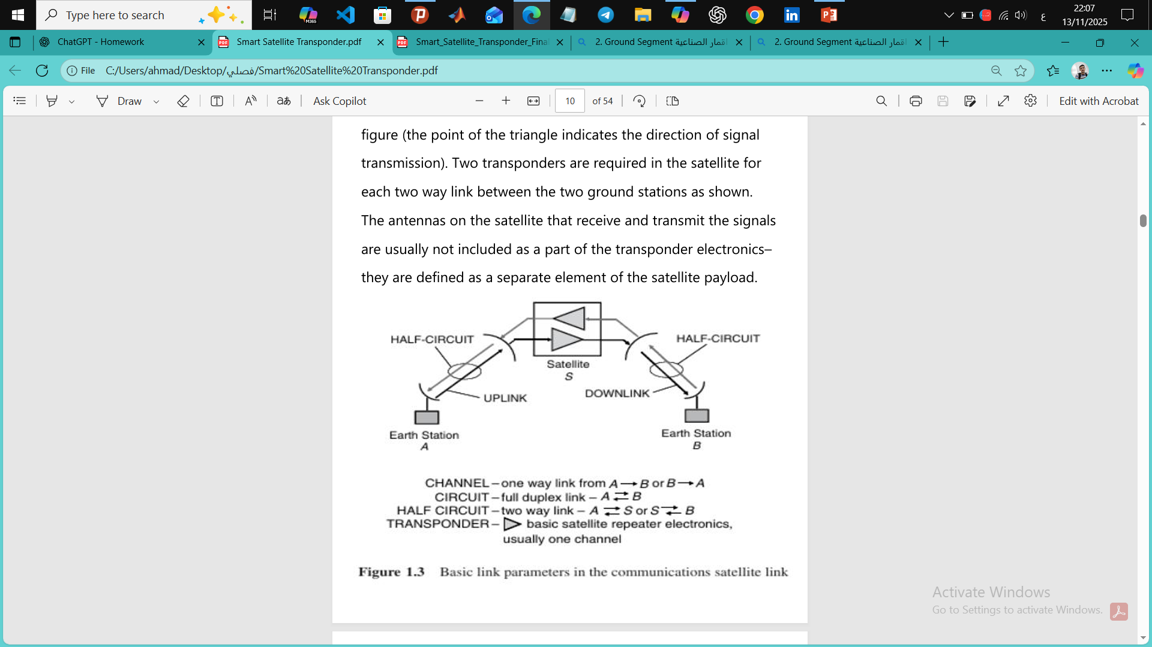
4.1.3_Satellite Link Parameters
4.1.4Frequency Band
Form c_4.1.3
Form d_4.1.4

Slide 9
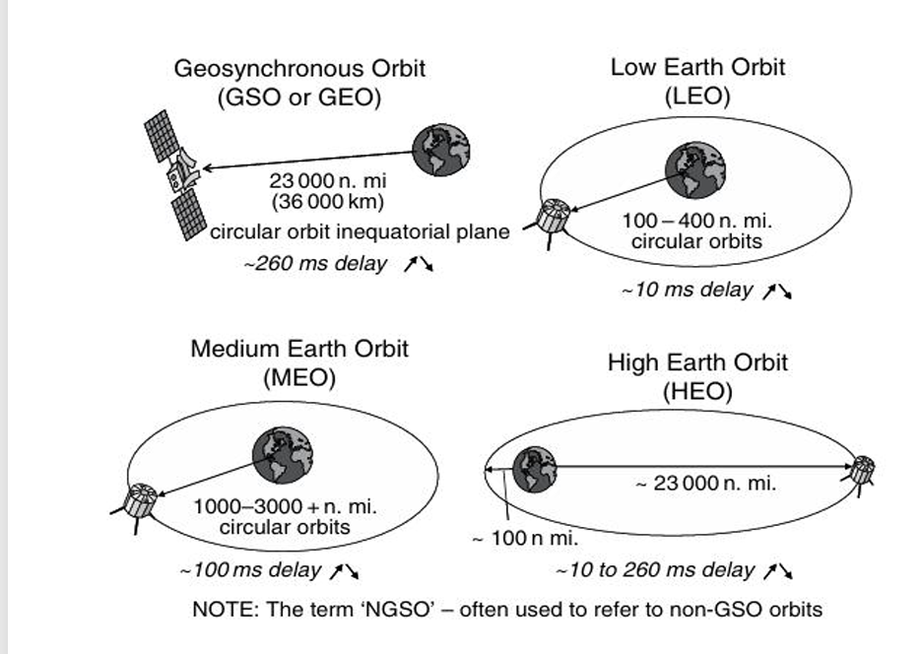
4.2_Satellite Orbits :
Form a_4.2

Slide 10
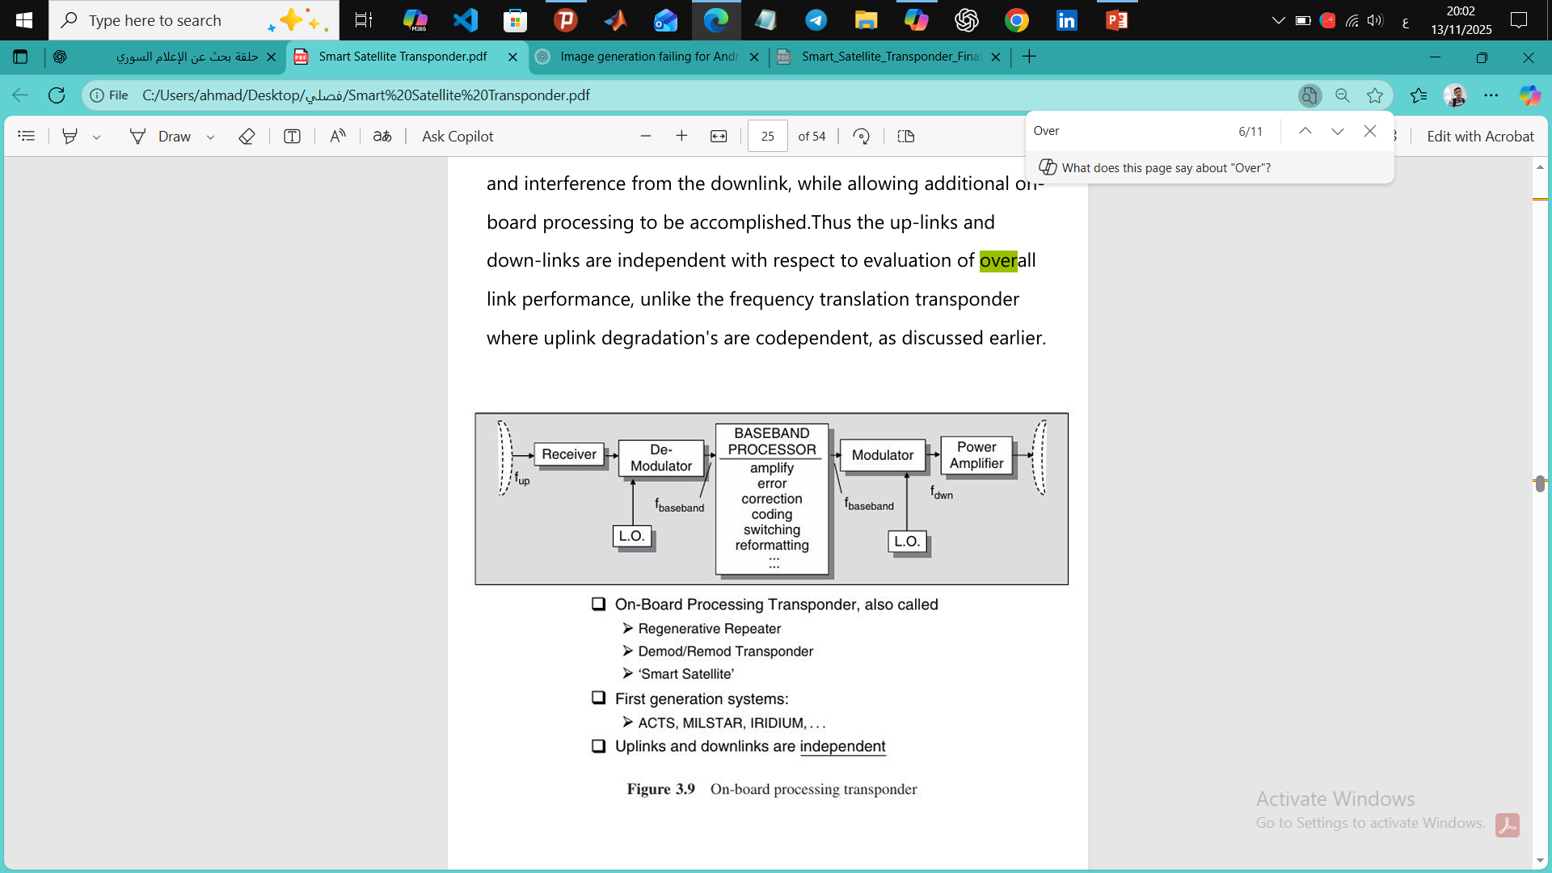
4.3_On-board Processing :
Form a_4.3

Slide 11
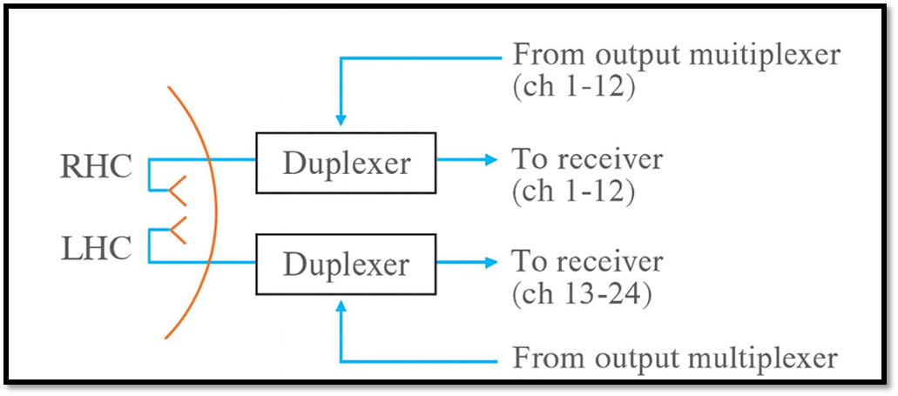
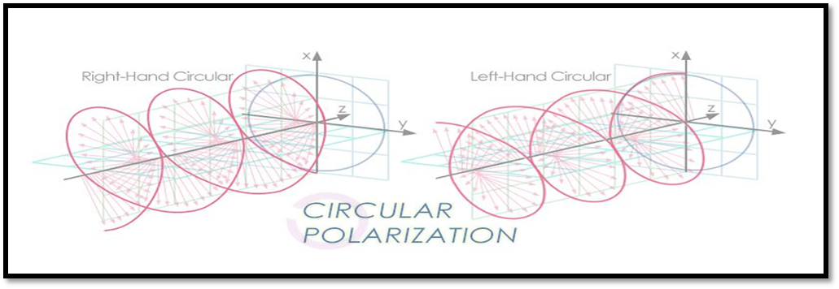
4.4_Polarization Diversity :
Uses RHC and LHC polarizations to double channel capacity.
Shared antenna with dual polarization element.
Separate transmit/receive paths maintain isolation.
Form a_4.4
Form b_4.4

Slide 12
5_Implementation Smart Transponder Architecture :
Main Components & Architecture

Slide 13
5_Implementation Smart Transponder Architecture :
5.1_Main Components:
Duplexer
Band pass Filter
LNA
Mixer
IF Amplifier
IMUX
HPA
OMUX

Slide 14
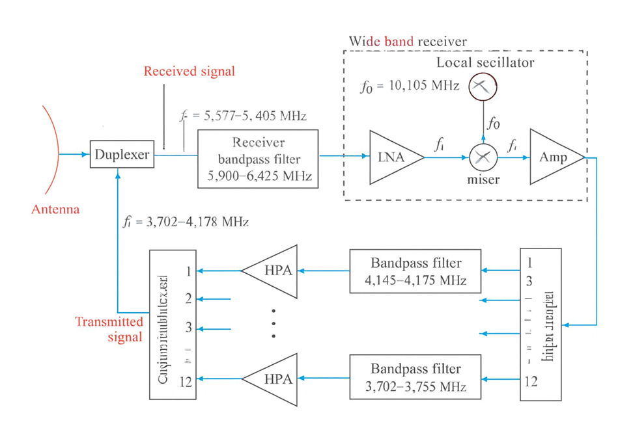
5.2_Transponder Architecture :
Form 1-3.2

Slide 15
6- References:
1-Satellite Communications Systems Engineering Louis J. Ippolito, Jr.
2-E.ImboldiandD.Hershberg,‘CourierSatelliteCommunicationsSystem ,’AdvancesintheAstronauticalSciences, Vol. 8, 1961.
3-IEEETransactionsonAerospaceandElectronicsSystems.
4-D.Roddy,SatelliteCommunications,ThirdEdition,McGraw-Hill,NewYork,2001.
5-T. Pratt, C.W. Bostian and J.E. Allnutt, Satellite Communications, Second Edition, John Wiley & Son, Inc., NewYork, 2003.

Slide 16
Thank You

